Slide 1
The regulation of lawyers and legal services in Aotearoa New Zealand Te pae whiritahi i te korowai rato ture o Aotearoa
Independent Review Panel webinar
July 2022

Slide 2
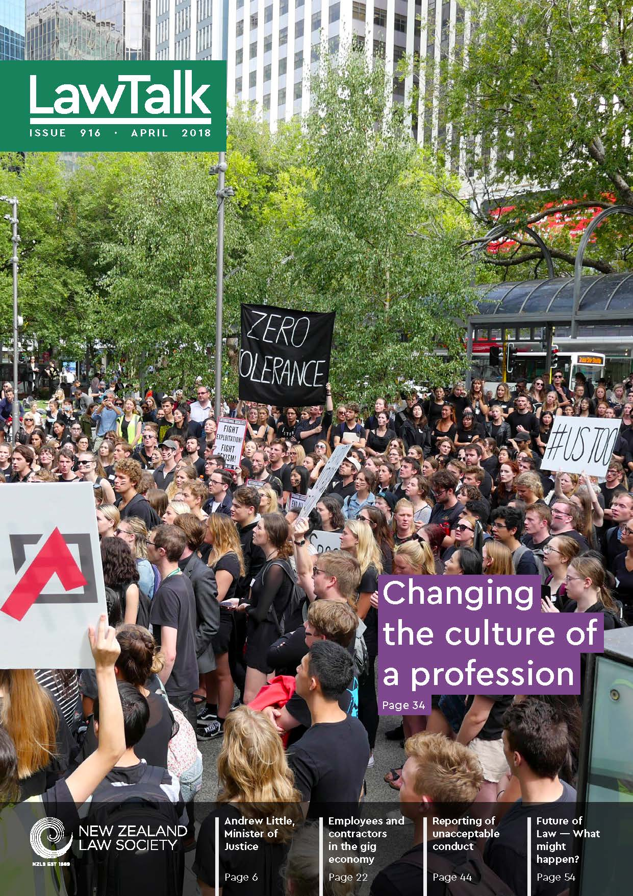
Why are we doing this review?
concerns about sexual harassment, bullying and poor mental health in the legal profession
delays and lack of transparency in complaints system
reforms of regulatory models for lawyers internationally and in other NZ professions
changing expectations re cultural competence in diverse population
how to acknowledge te Tiriti and biculturalism in statutory framework?
how to promote innovation and competition in delivery of legal services?

Slide 3
Wide scope
whether the Law Society’s regulatory and representative functions should be separated
how unacceptable conduct is prevented and addressed
how complaints are made and responded to
which legal services are regulated
optimal organisational and governance arrangements for the Law Society
the role te Tiriti should play in the statutory framework and regulator governance
how inclusion and diversity should be expressed in the regulatory framework

Slide 4
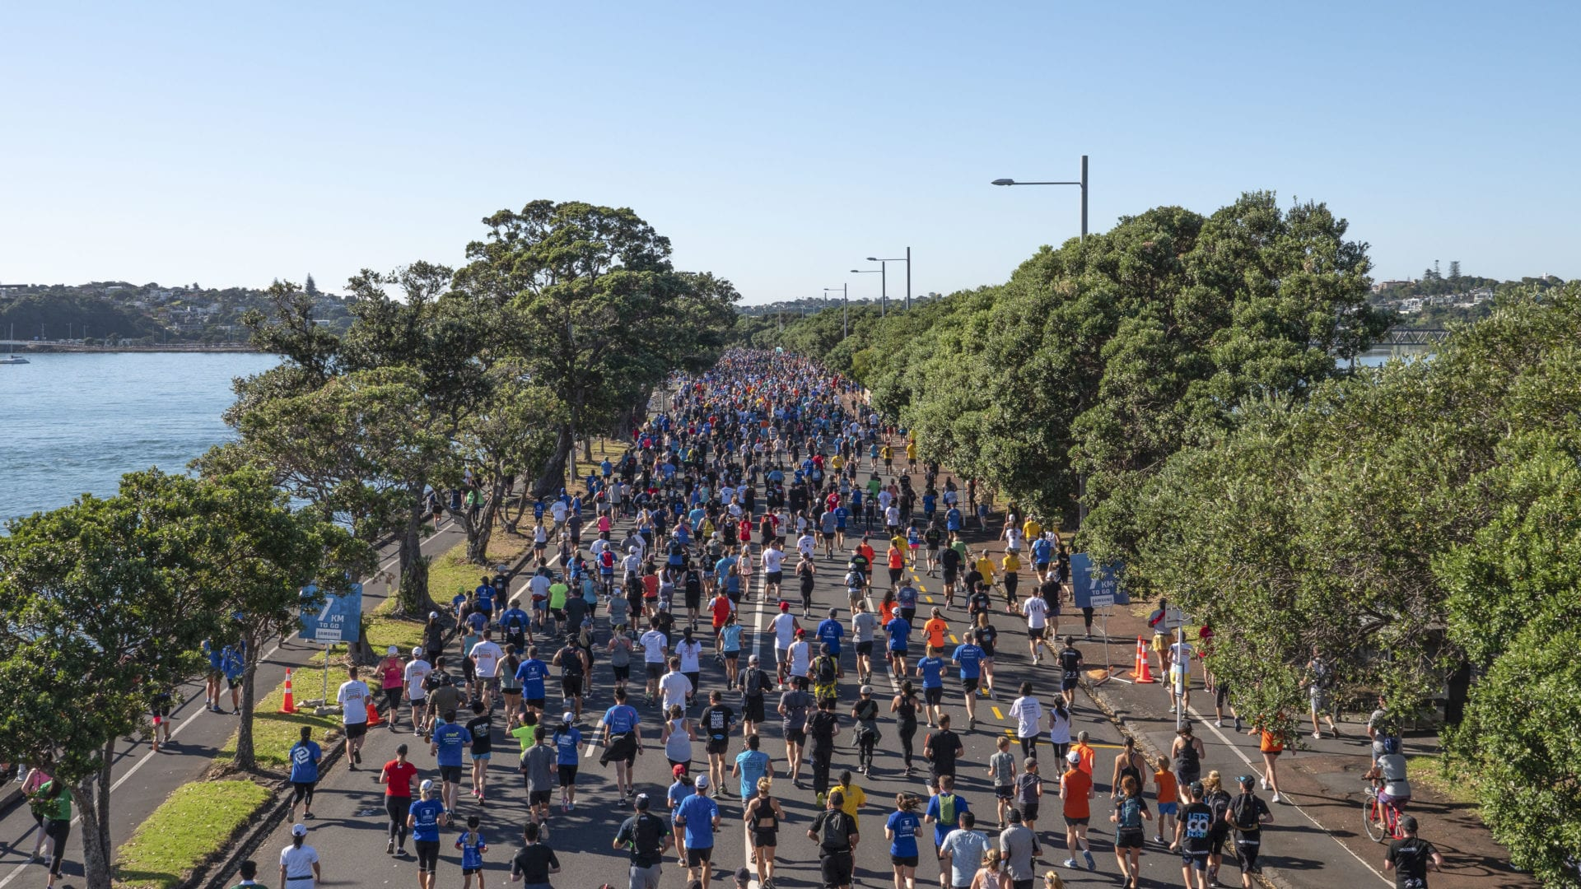
Review process
Panel appointed 1 March 2022
Our task is to identify changes needed for fit-for-purpose regulation and representation of lawyers in 21st century
Discussion document released in June
July-August consultation with the profession, consumer groups and policy makers
Meetings with regulators and experts in UK, Australia, Canada, June-Sept
Final report to NZLS Board in December

Slide 5
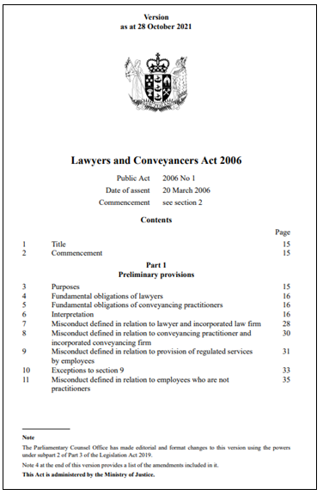
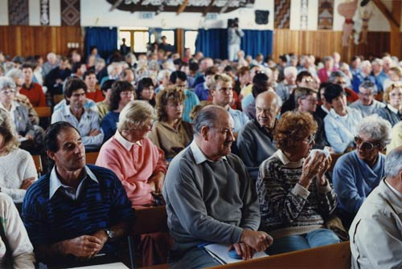
Is the statutory framework fit for purpose?
The Act:
does not set regulatory objectives
is silent on te Tiriti
focuses on protecting titles, rather than the risk to consumers
restricts corporate models
focuses regulation on individuals, not entities
sets a prescriptive model for handling complaints

Slide 6
How can the complaints model be improved?
the current model is not working - slow, adversarial and lacks transparency
many of the problems are caused by factors outside of the Law Society’s control
we are consulting on options for wholesale reform of the model

Slide 7
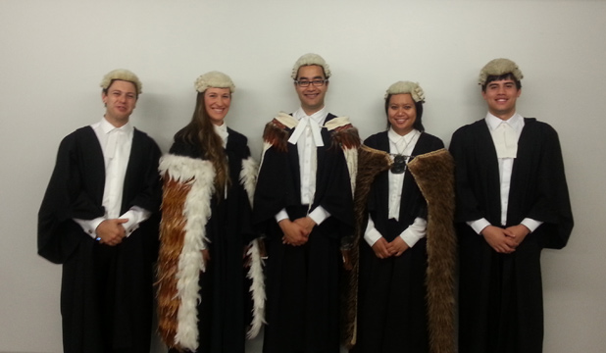
How can the profession strengthen its commitments to te Tiriti o Waitangi?
bicultural foundations, reconciliation, te reo and tikanga are growing in importance for the practice of law
should te Tiriti be incorporated into the Act?
how can a regulator/representative body better reflect te Tiriti?

Slide 8
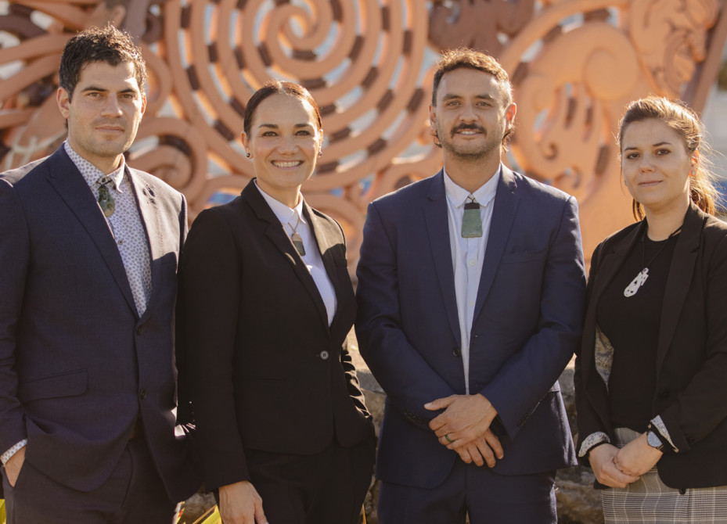
How to promote a positive and diverse culture within the legal profession?
how can we promote good conduct and support wellbeing to ensure safe workplaces?
why are so many junior lawyers leaving the profession? why do barriers still exist for so many?
does the regulator need new tools?
we are consulting on what further steps are needed

Slide 9
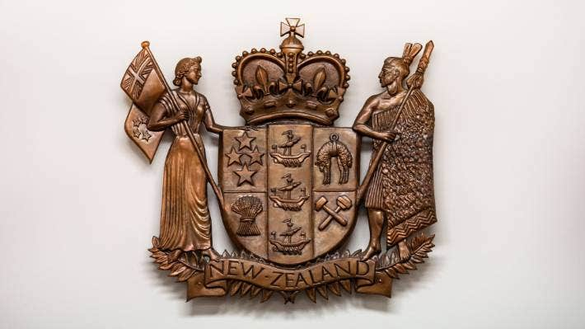
Is there a case for an independent regulator?
international trend towards independent regulation of lawyers
the status quo has some benefits, but the issue is whether these come at a cost to the profession and the public
we are consulting on a number of options – government regulation is not on the table

Slide 10
What should governance arrangements look like for a regulator / membership body?
Possible issues with current structure:
role of elections (regulator)
lack of competency appointments
25-member Council
lack of lay members
historic lack of diversity
We’re also consulting on how to reflect te Tiriti in governance arrangements

Slide 11
Where to from here?
We are seeking comments by 12 August:
written submissions/comments: secretariat@legalframeworkreview.org.nz
an online survey: www.surveymonkey.com/r/nzlawreview
We are holding meetings around the country, and the Law Society and member organisations will be holding a series of events

Slide 12
We look forward to hearing your views!
Independent Review Panel webinar
July 2022

